Slide 1

SCSA1401
OBJECT ORIENTED ANALYSIS AND SYSTEM ENGINEERING
BY
Ms. B. KEERTHI SAMHITHA & Ms. SUJA. C. M
Assistant Professor
Department of CSE

Slide 2
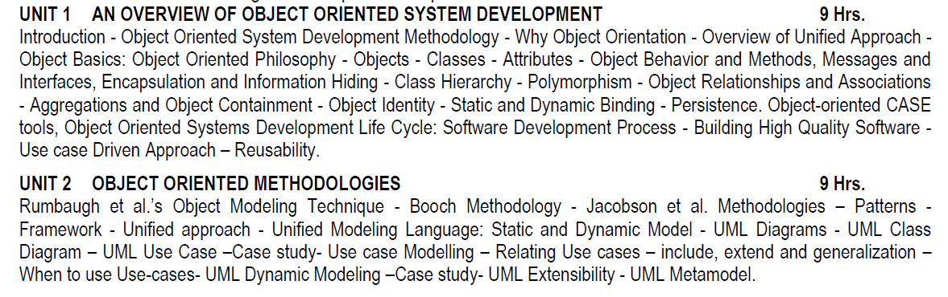
SYLLABUS

Slide 3
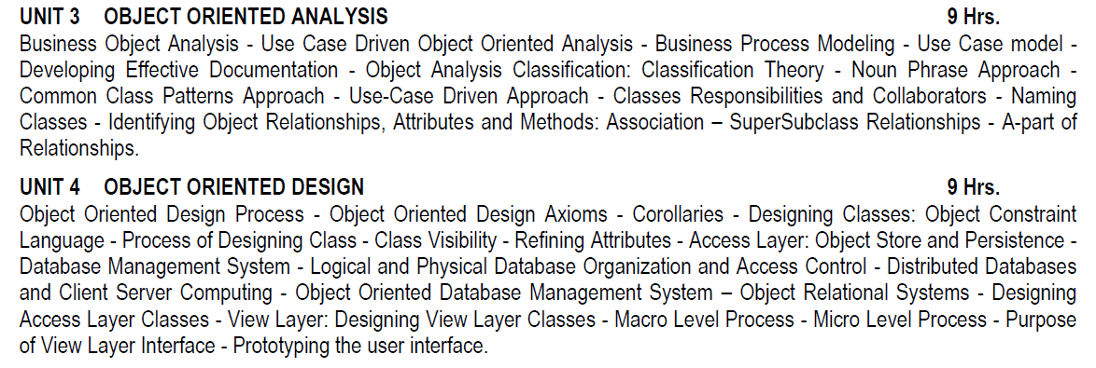
SYLLABUS

Slide 4
SYLLABUS

Slide 5
COURSE OUTCOMES
CO | DESCRIPTION
CO 1 | Understand the basics object model for System development.
CO 2 | Understand the object Oriented Methodologies
CO 3 | Express software design with UML diagrams.
CO 4 | Understand the concept of Relationships.
CO 5 | Design software applications using OO concepts
CO 6 | Understand the various testing methodologies for OO software.

Slide 6
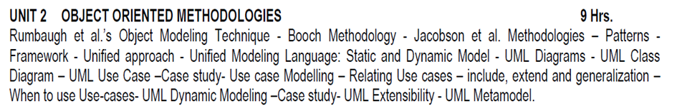
UNIT 2
OBJECT ORIENTED METHODOLOGIES

Slide 7
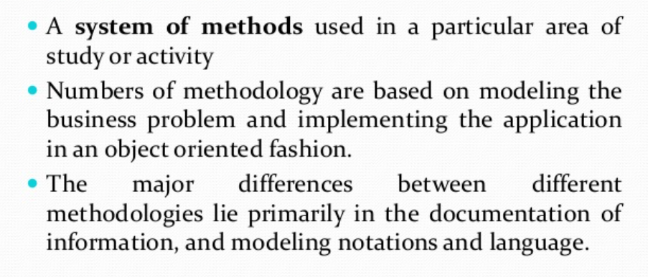
INTRODUCTION

Slide 8
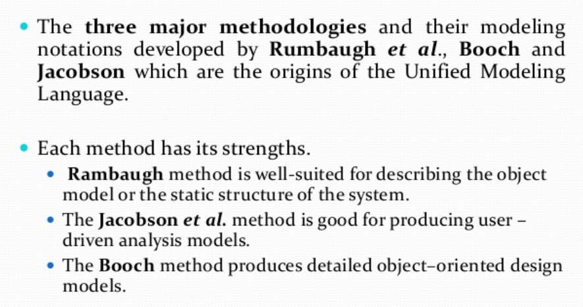
INTRODUCTION

Slide 9
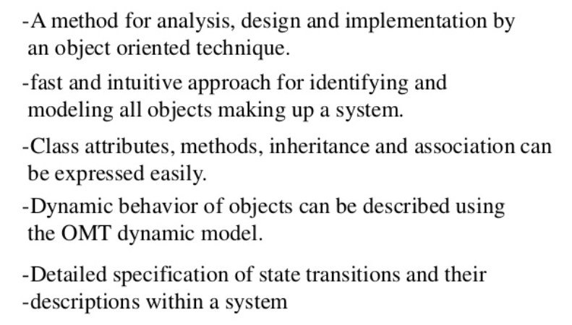
RAMBAUGH’S OBJECT MODELING TECHNIQUE (OMT)

Slide 10
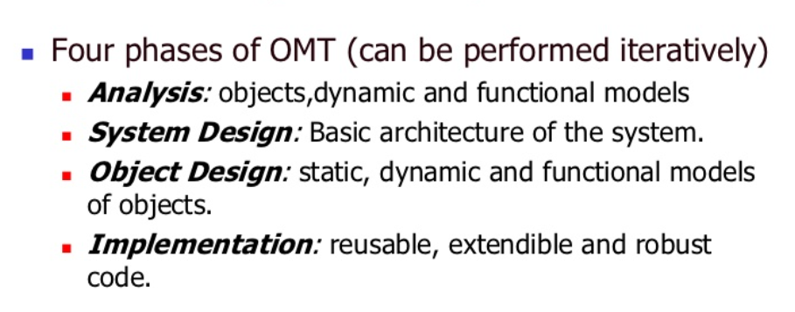
RAMBAUGH’S OBJECT MODELING TECHNIQUE (OMT)

Slide 11
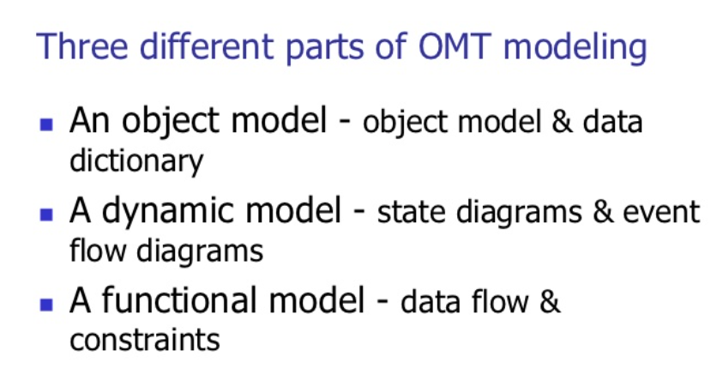
OMT MODELING

Slide 12
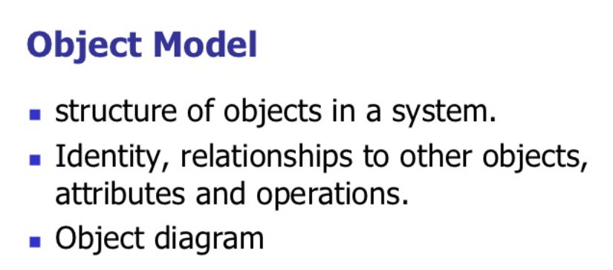
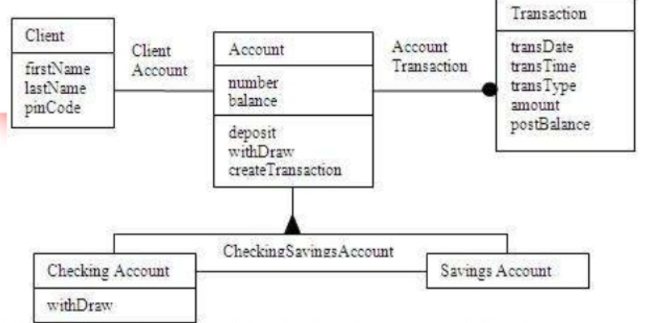

Slide 13
OBJECT MODEL
The OMT object model of a bank system.
The boxes represent classes and the filled triangle represents specialization.
Association between Account and Transaction is one to many; since one account can have many transactions, the filled circle presents many (zero or more).
The relationship between Client and Account classes is one to one:
A client can have only one account and account can belong to only one person (in this model joint accounts are not allowed).

Slide 14
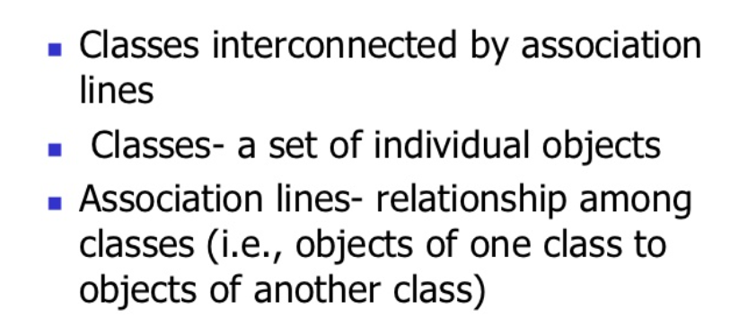
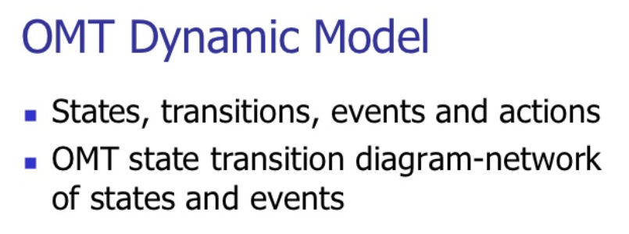
OBJECT DIAGRAM

Slide 15
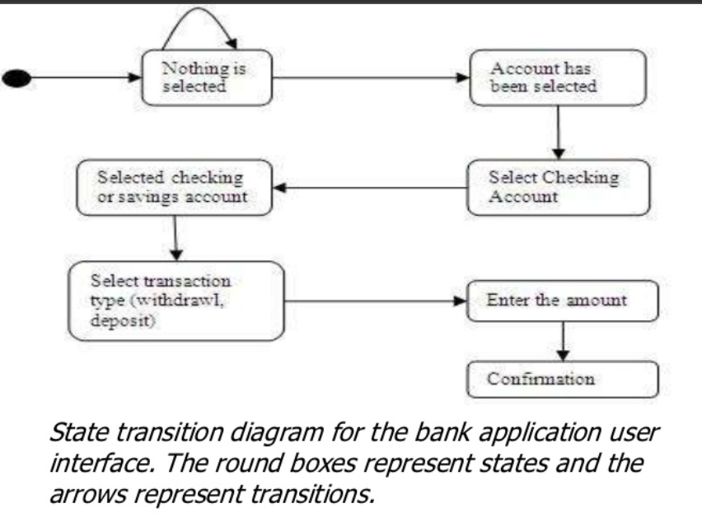

Slide 16
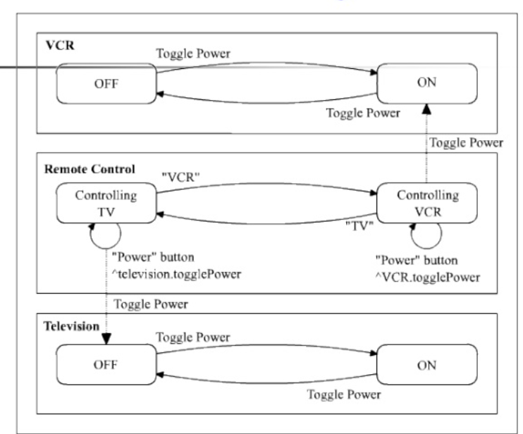
STATE TRANSITION DIAGRAM

Slide 17
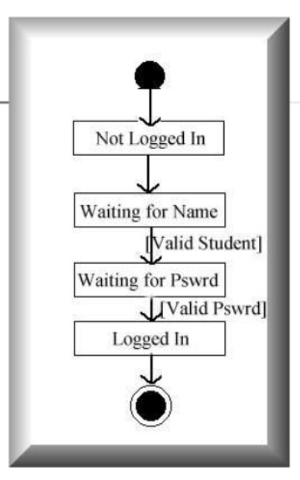

Slide 18
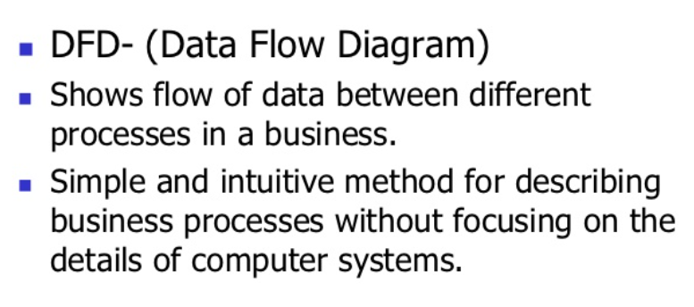
OMT FUNCTION MODEL

Slide 19
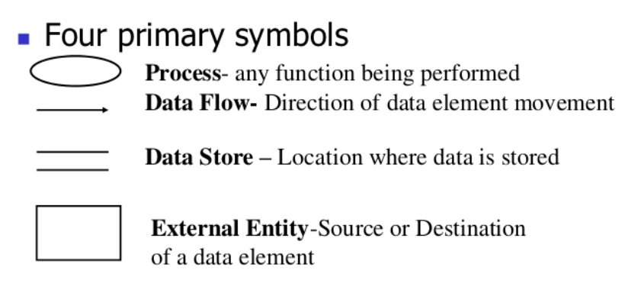
DATA FLOW DIAGRAM

Slide 20
DATA FLOW DIAGRAM
Four primary symbols Process
Any function being performed Data Flow
Direction of data element movement Data Store
Location where data is stored External Entity
Source or Destination of a data element

Slide 21
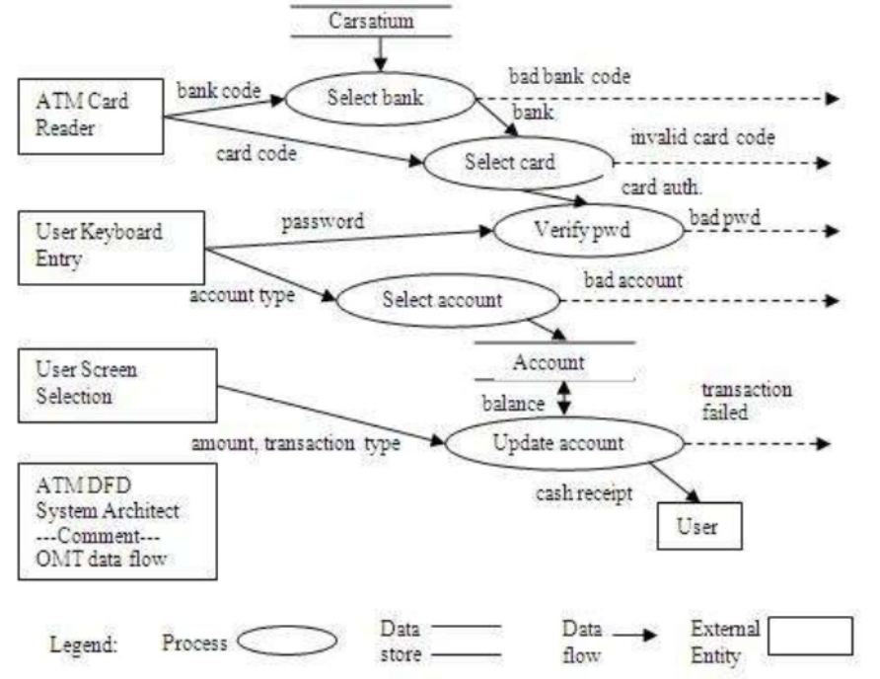

Slide 22
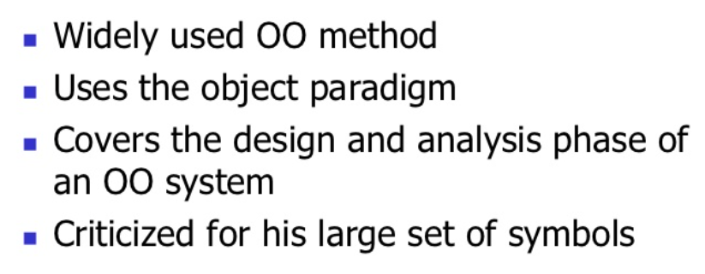
THE BOOCH METHODOLOGY

Slide 23
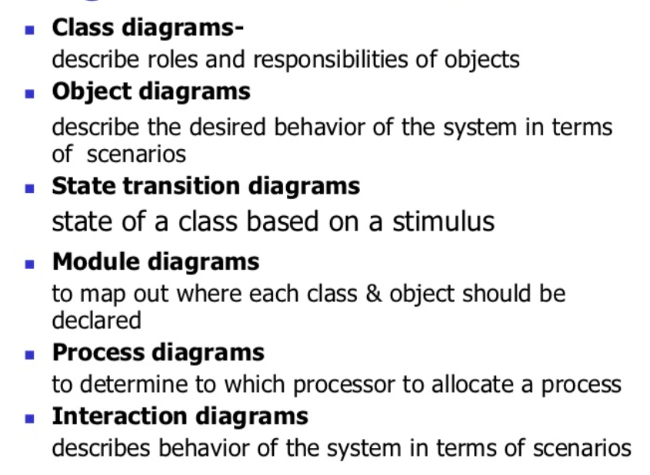
DIAGRAMS OF BOOCH METHOD

Slide 24
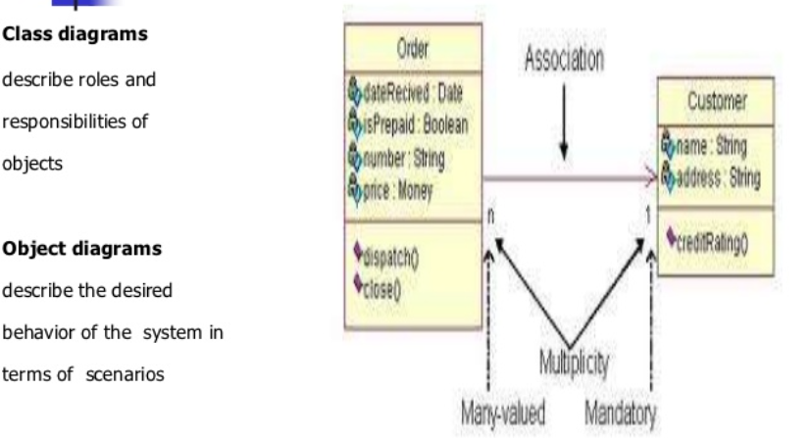

Slide 25
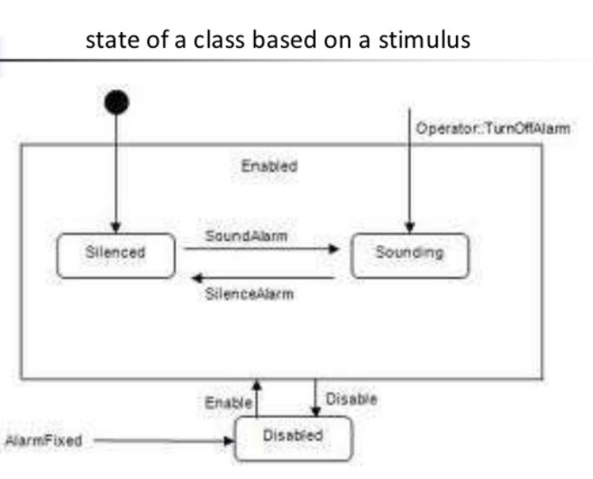
STATE TRANSITION DIAGRAM

Slide 26
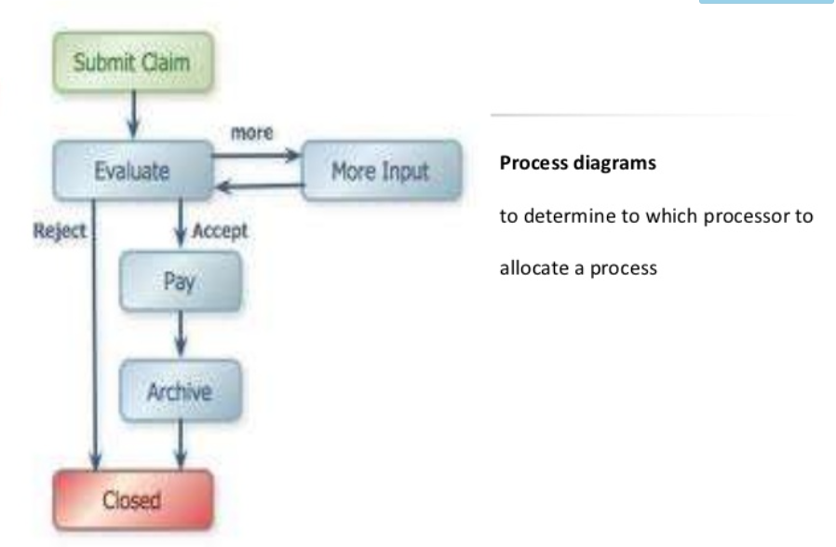
PROCESS DIAGRAM

Slide 27
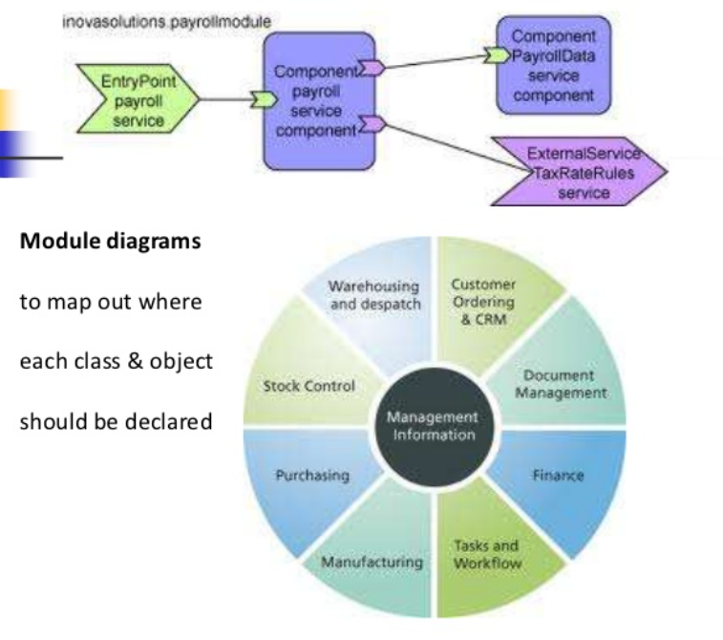
MODULE DIAGRAM

Slide 28
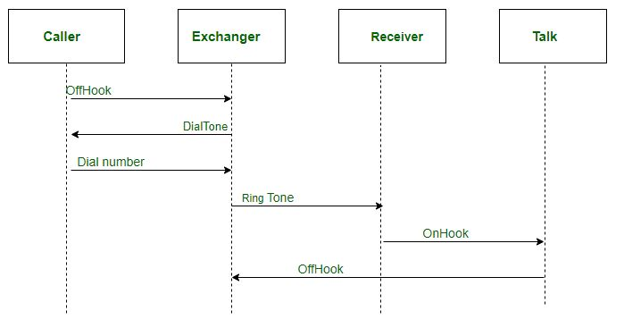
INTERACTION/SEQUENCE DIAGRAM

Slide 29
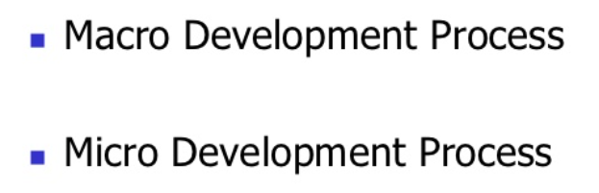
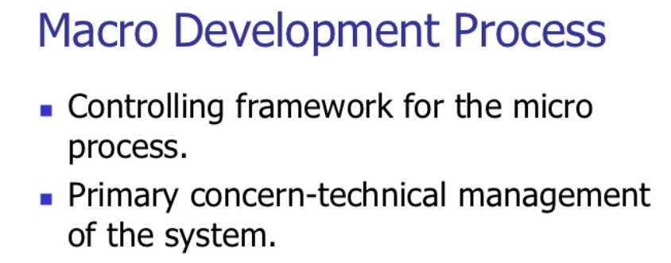
BOOCH METHOD PRESCRIBES

Slide 30
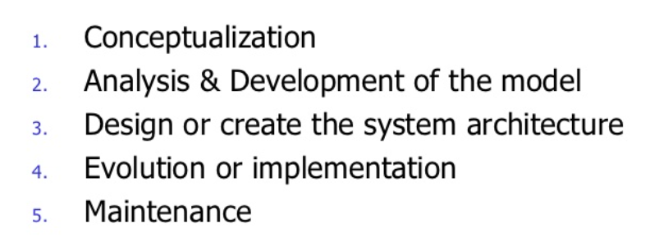
STEPS FOR MACRO DEVELOPMENT PROCESS

Slide 31
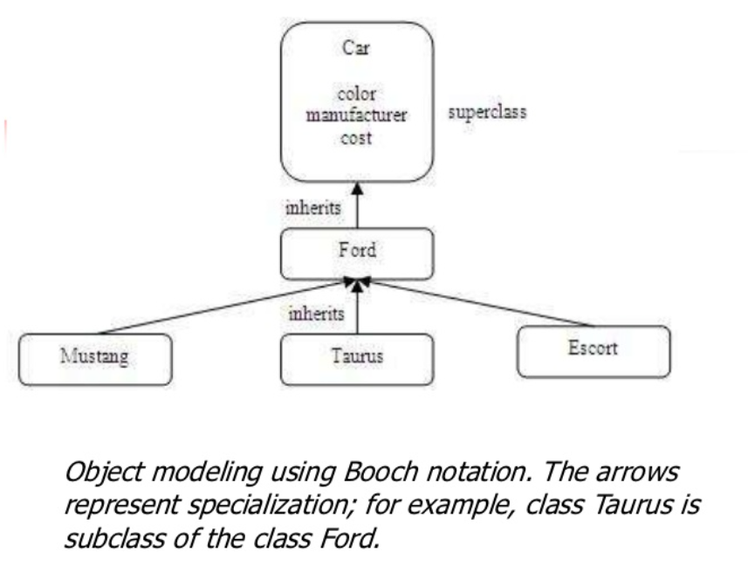

Slide 32
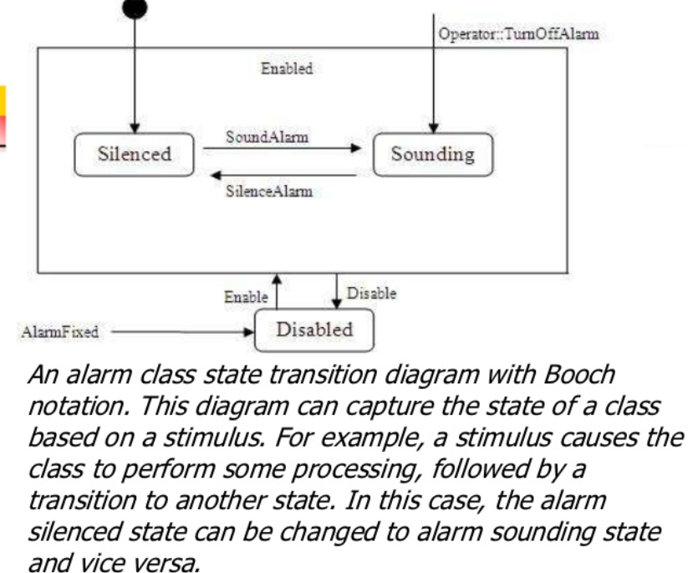

Slide 33
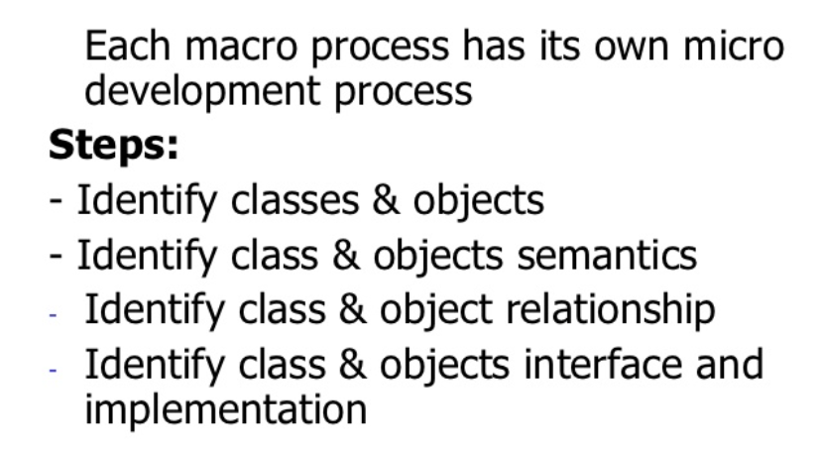
MICRO DEVELOPMENT PROCESS

Slide 34
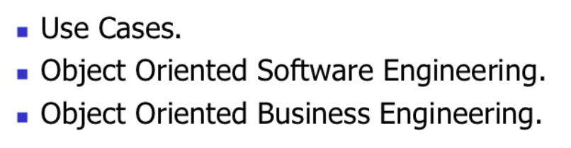
JACOBSON METHODOLOGIES

Slide 35
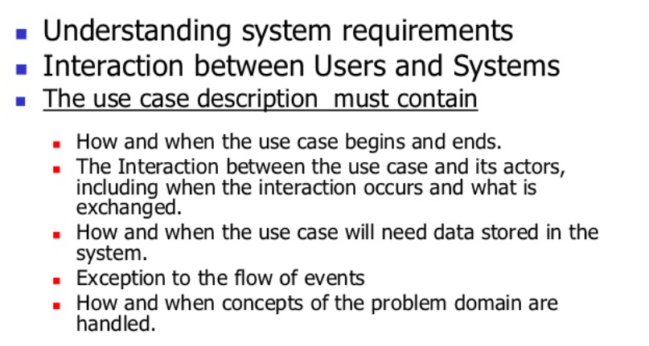
USE CASES

Slide 36
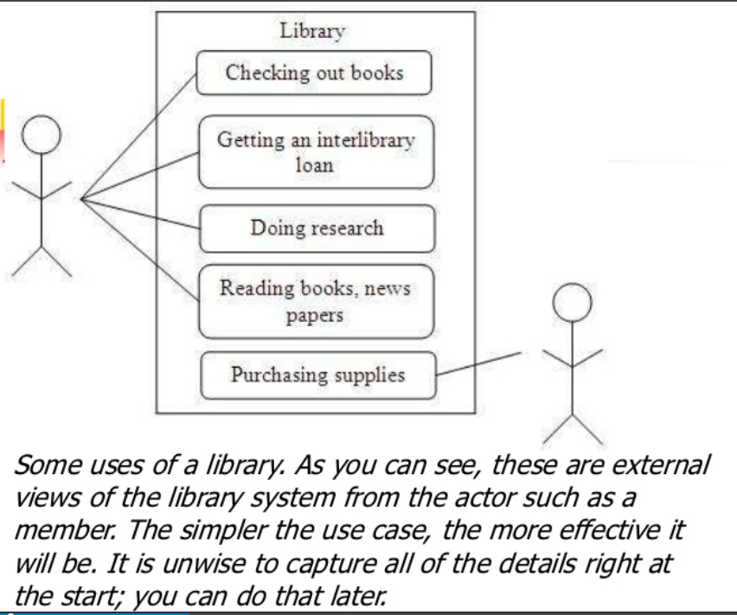

Slide 37
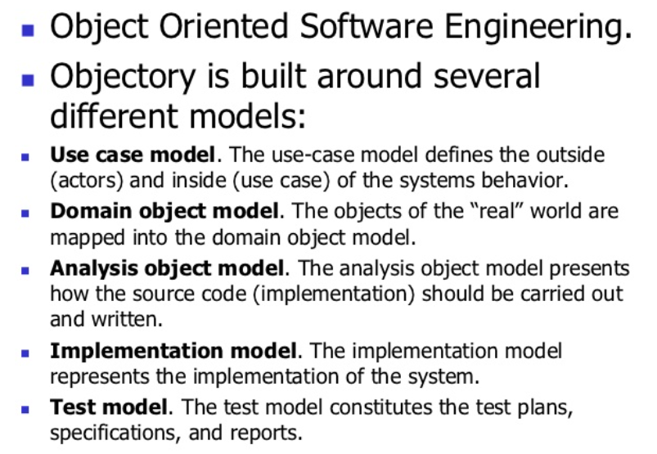
OBJECT ORIENTED SOFTWARE ENGINEERING

Slide 38
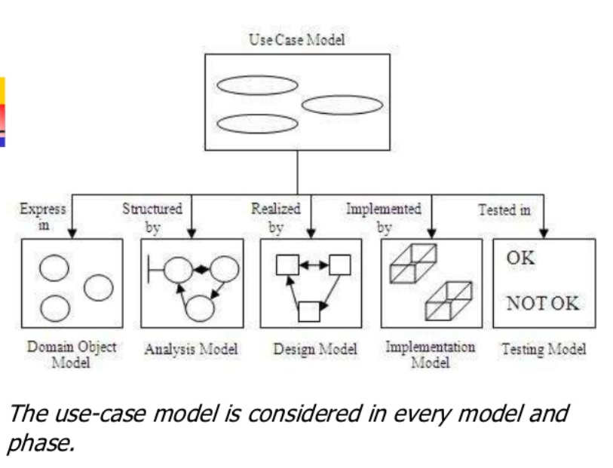

Slide 39
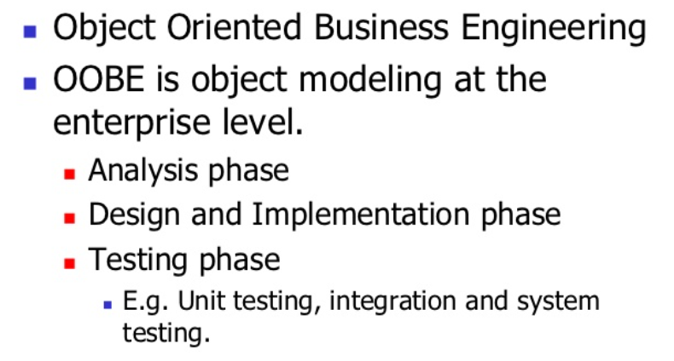
OBJECT ORIENTED BUSINESS ENGINEERING

Slide 40
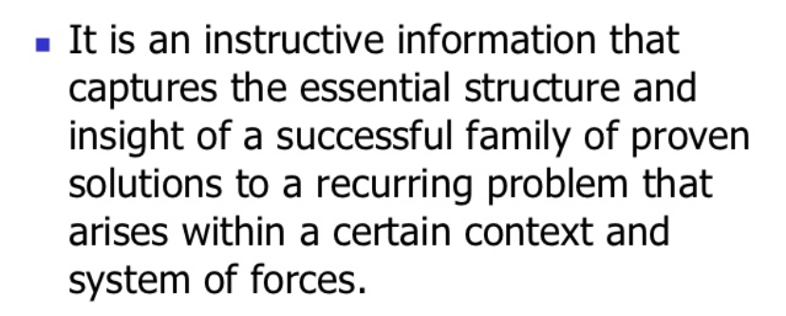
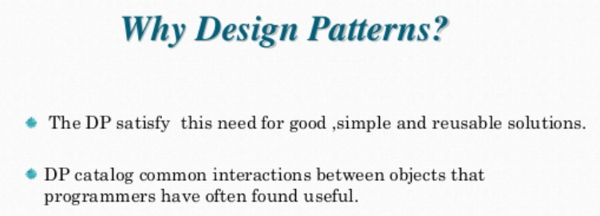
PATTERN

Slide 41
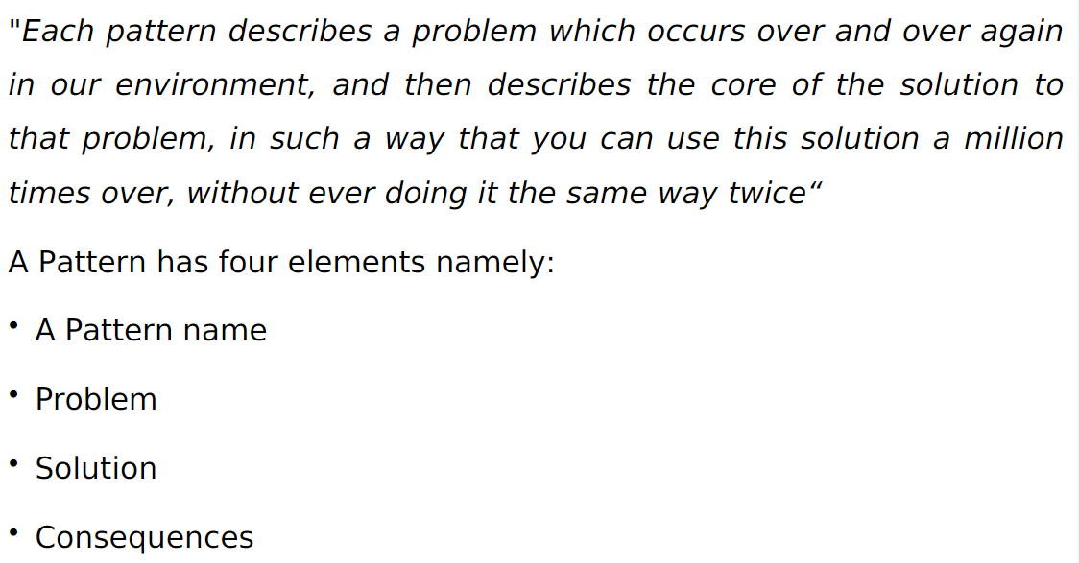
PATTERN

Slide 42
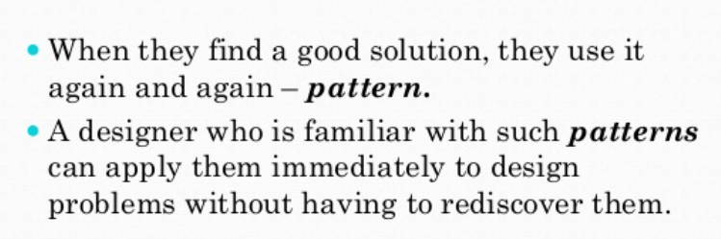
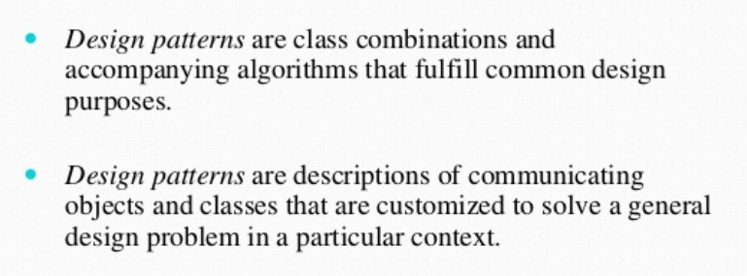
DESIGN PATTERN

Slide 43
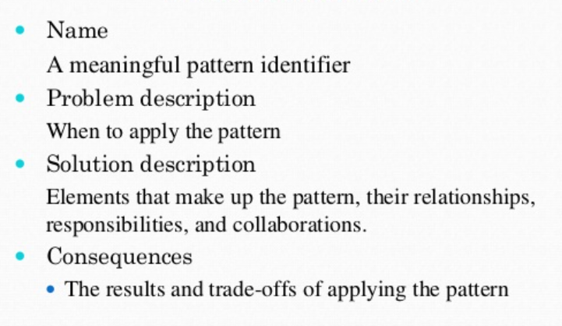
PATTERN ELEMENTS

Slide 44
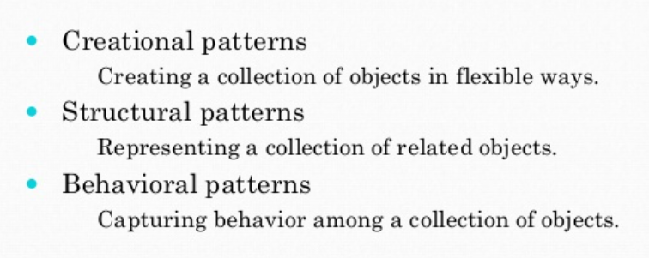
TYPES OF DESIGN PATTERN

Slide 45
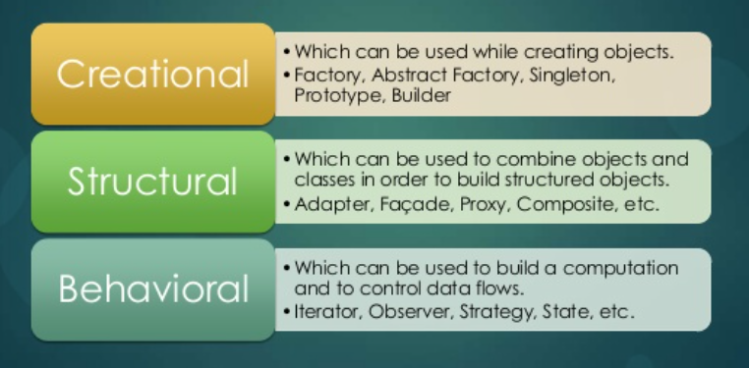
CATALOG FOR DESIGN PATTERN

Slide 46
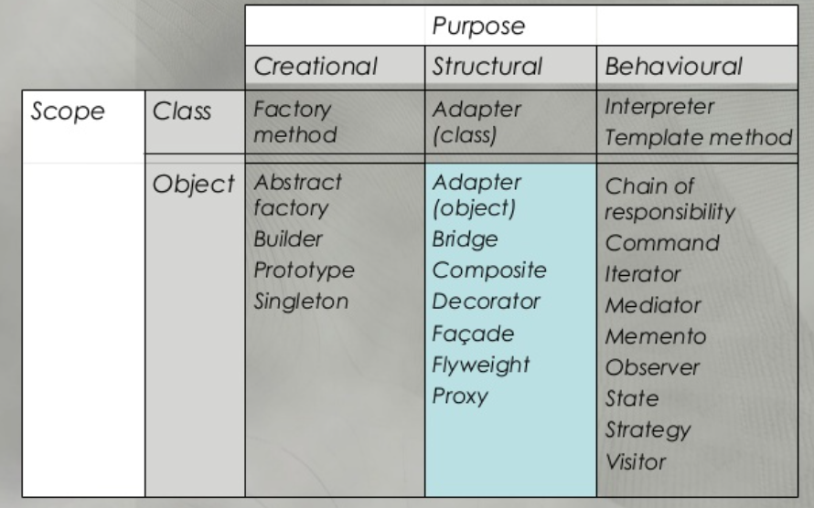
CATALOG FOR DESIGN PATTERN

Slide 47
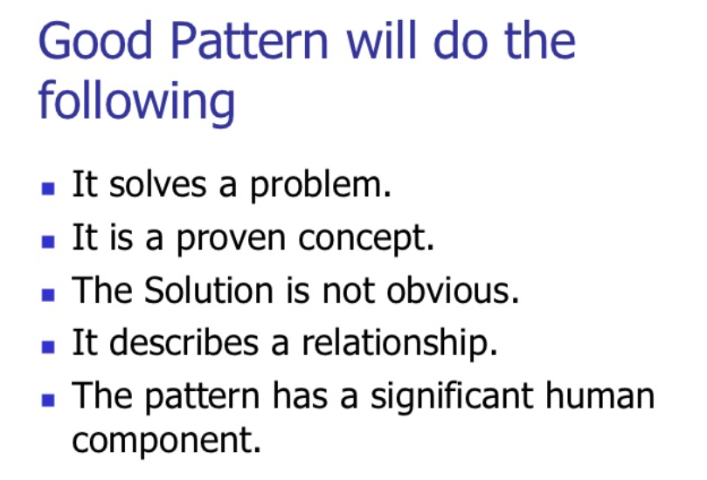
PATTERN

Slide 48
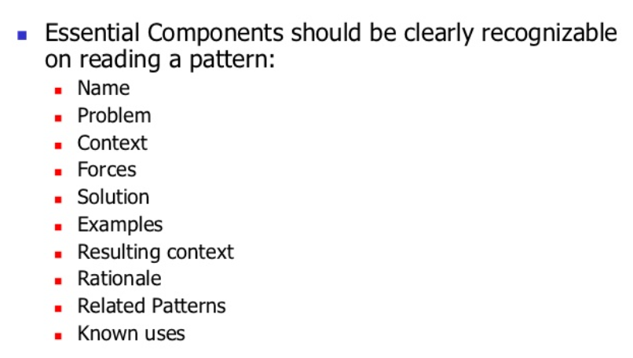
PATTERN TEMPLATE

Slide 49
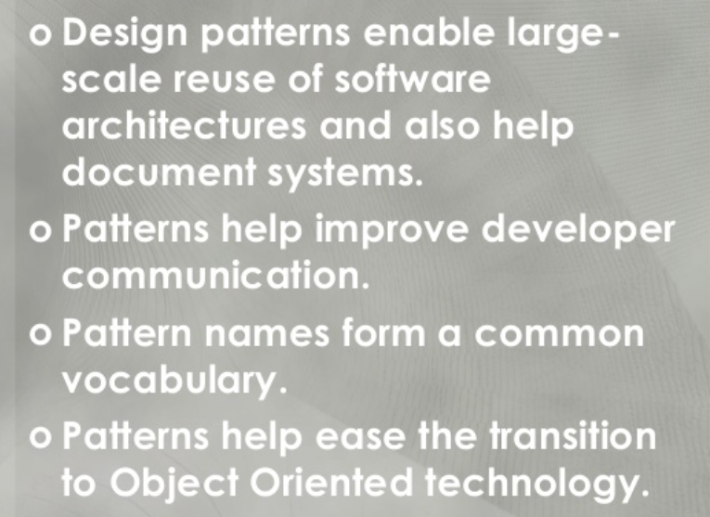
BENEFITS OF DESIGN PATTERN

Slide 50
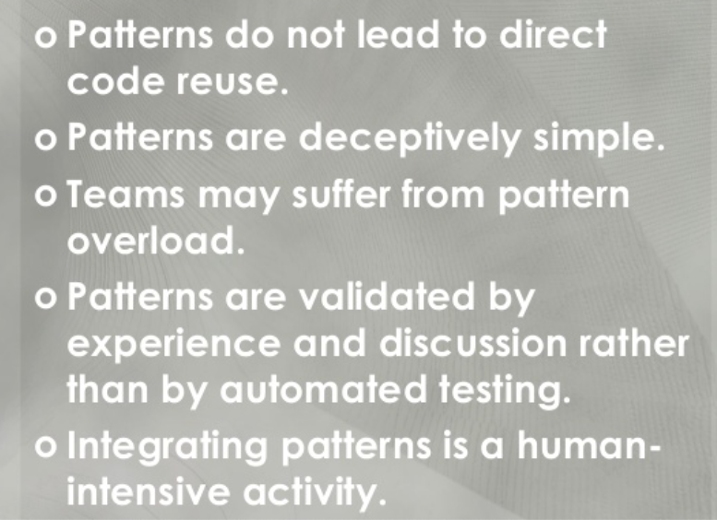
DRAWBACKS OF DESIGN PATTERN

Slide 51

FRAMEWORK

Slide 52


Slide 53


Slide 54

UML : UNIFIED MODELLING LANGUAGE

Slide 55

UML

Slide 56

STRUCTURAL

Slide 57

BEHAVIORAL

Slide 58

ARCHITECTURAL

Slide 59

TYPES OF UML

Slide 60

UML : STATIC AND DYNAMIC MODELING
STATIC MODELING

Slide 61

STATIC MODELING

Slide 62


Slide 63


Slide 64

DYNAMIC MODELING

Slide 65


Slide 66


Slide 67



Slide 68


Slide 69


Slide 70

UML : USE CASE MODELING

Slide 71


Slide 72

USE CASE

Slide 73

USE CASE

Slide 74

RELATIONSHIP : RELATING USE CASE

Slide 75

EXTEND RELATIONSHIP

Slide 76

GENERALIZATION

Slide 77

WHEN TO USE USECASES

Slide 78

USECASE EXTENSIBILITY

Slide 79

EXTENSIBILITY IN UML

Slide 80

USECASE METADATA

Slide 81

TYPES OF METADATA

Slide 82


